Slide 1
INTRODUCTION TO SOFTWARE
ENGINEERING

Slide 2
Evaluation Guidelines
ISA -1 : 60 marks reduced to 30 marks
ISA -2 : 40 marks reduced to 20 marks
ESA- : 100 marks reduced to 50 marks

Slide 3
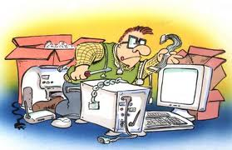
Context of Software Engineering

Slide 4
Objectives for this capsule
Why Software Engineering
What is Software
What are Software products
What is Engineering
What is Software Engineering
Contrasting Computer Science and Software Engineering

Slide 5
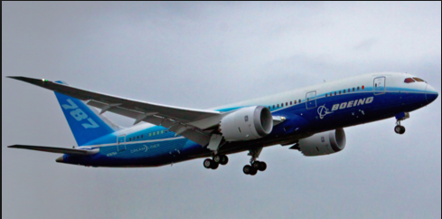
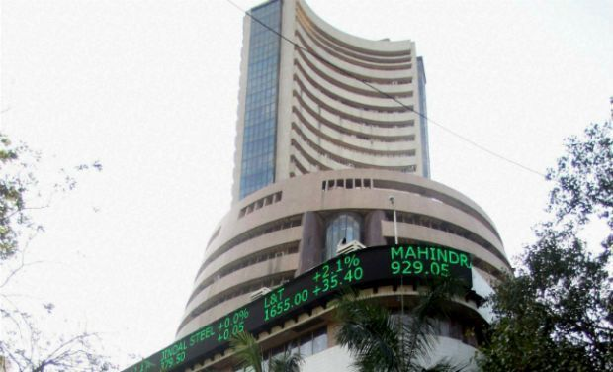
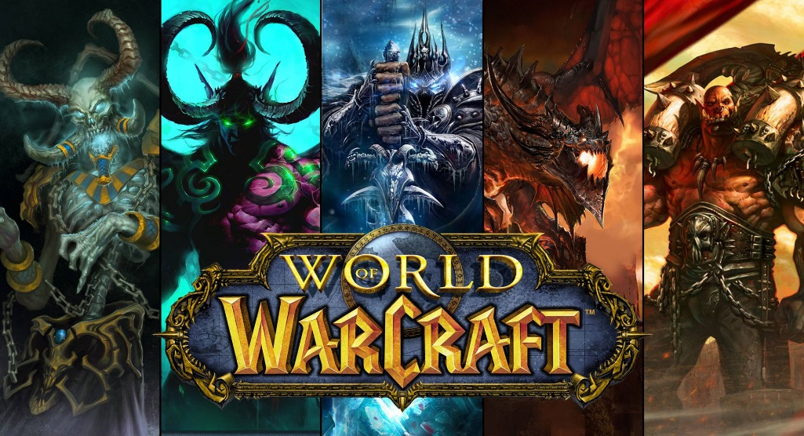

Look at the Pictures
Amazon.com

Slide 6
What’s expected from these
Machine which flies
Supports going to a specified place
Carries people and goods
Reliably functions
Market System supporting buying and selling of stocks/bonds/ securities
Supports buyers and sellers to be local/remote for all transactions
Regulation, Data Integrity, Security

Slide 7
What’s expected from these
System to play a video game for entertainment and competition
Supports individuals and groups
Runs on dedicated or general purpose systems
Supports various levels of skills and complexity
Amazon.com
Supports a market place featured around a web site
Will have number of upgrades and revisions

Slide 8
What do they have in common
Code
(and lots of It)

Slide 9
Looking at it in more detail
A Boeing 747 has more lines of code than the parts of the aeroplane including nuts and bolts
~ 5 Million lines of Code
Most Games have
~ 6 Million or more lines of code
(and this has to be done on different systems and different OSs etc.)

Slide 10
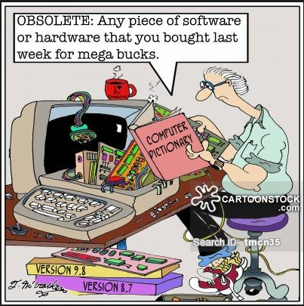
Diminishing value
… has to be dealt with

Slide 11
Impact?
In an environment like Amazon, say if one small upgrade had a problem and caused a 90 min outage.
Can you foresee the impact due to this outage?
– Loss 2.8M$ revenue
– Loss of customers
All of these have to be functioning in a user friendly way
Expectation is that you do not have errors
- This has to be factored in
- These also needs to be factored in

Slide 12
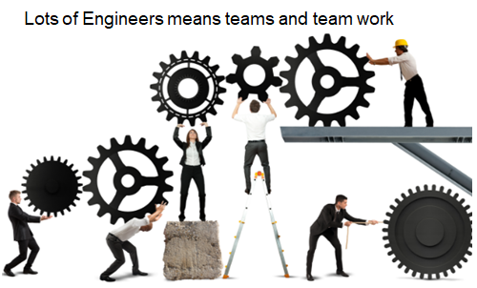


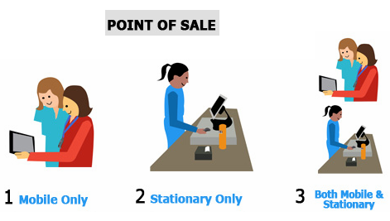

Leading to
Need for interacting with customers and other stake holders on what is needed
Need for understanding who and how is this going to be used
Need Experts in different domains to support this (Cross)
Need for good Planning
Need for good Teamwork
Need to have an ability to scale/support
Lets assume an Engineer can code 1 LOC a min
Then
1 LOC/min * 60 min/hr = 60 LOC/hr
Say for 40 hrs/Wk, 60*40 = 2400 LOCs/week/SE
-> 2400 LOC/week * (~)50 = 1,20,000 LOCs/Yr/SE
So lots of engineers will need to be working for long period of time

Slide 13
Given all of this context
If we look at some of the definitions involved
Software can be collection of executable computer programs (code), their configuration files and associated libraries and their documentations serving a computational purpose.
Software Product is Software when made for a specific or specific group of requirements
Software can include prefixes as Generic, Custom, System and Application
Engineering is all about acquiring and using well defined scientific principles and systematic methods for developing products, with economic sense, social perspective and practical considerations.
Involves making decisions or making choices given a context
Notes:
Software is not manufactured in the classical sense and does not wear out.
Software may be
Generic software - developed to be sold to a range of different customers e.g. PC software such as Excel or Word.
Custom software - developed for a single customer according to their specification.
System Software – designed to operate/manipulate hardware
Application software – developed to perform any task/function that benefits from computation
Programming Infrastructure software - Programs or applications that software developers use to create, debug, maintain, or otherwise support other programs and applications.
New software can be created by developing new programs, configuring generic software systems or reusing existing software or piecing together different software.

Slide 14
Software Engineering (SE)
Software Engineering is the systematic, disciplined, quantifiable approach towards the development, operation, and maintenance of software products.
A software product developed using Software Engineering principles has a higher probability of being efficient and reliable.
Software Engineering principle drives usage of appropriate tools and techniques depending on the problem to be solved, while considering the constraints and resources available
Focuses more on techniques for developing and maintaining software that is correct from its inception
Notes:
Software engineering is beyond programs people write for something/hobby
Software engineering is an engineering discipline that is concerned with all aspects of software production.
Software engineering can also be looked at as the systematic and scientific approach to develop, operate, maintain and to retire the software product. Software product could be interpreted as software for a large/medium size complex problem.
Software engineering is imperative in a large project, though there are benefits and can/and is good to be used for the development of programs/small assignments.

Slide 15
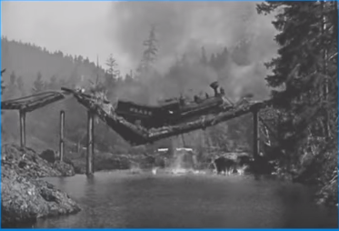


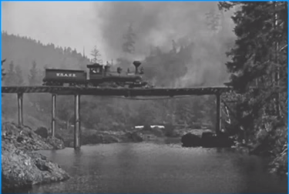
Is Computer Science == Software Engineering ?
Both of them go about solving problems using code but how they go about are different
E.g. A bridge collapse
Scientist build something to learn something new
Whereas
Engineer learns things to design and build quality products
Is it Scientists problem or an Eng. problem
Scientists want to achieve scientific breakthroughs
Whereas
Engineers want to avoid engineering failures

Slide 16
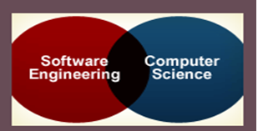
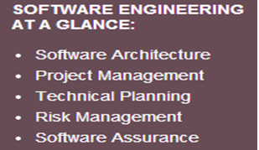
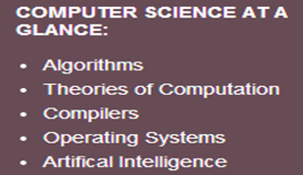
Is Computer Science == Software Engineering ?
Content differences:
Software engineering
Focuses on technical and managerial leadership for large and complex systems
It’s the foundation of enduring engineering principles which will support a lifetime of practice, amid emerging technologies.
Computer science
Focuses on foundations of computing including, algorithms, programming languages, theories of computing, artificial intelligence,.., and some hardware design.

Slide 17
Fundamental Drivers of Software Engineering (the Why’s)
Industrial Strength Software
Software is Expensive
Late and Unreliable
Can influence the life and death of a person
Heterogeneity
Diversity
Business and Social change
Security and Trust
Scale
Quality and Productivity
Consistency and Repeatability

Slide 18
Fundamental Drivers
Industrial Strength Software
needs to be
Operational : Functionality, Usability, Correctness …
Capable of being moved: Portability, Interoperability ..
Maintainable: Modularity, Maintainability, Scalability ..
have elaborate Documentation
absence/minimal number, of bugs is of primary importance
are Impactful to the business's leading to the need for strong processes for quality and resiliency

Slide 19
Fundamental Drivers
Software is Expensive
Software is labour intensive, Industrial-strength software is very expensive
Each line of code can cost from $5 to $35 when calculated across the lifecycle could go as high as $400
Software also has loads of Maintenance and Rework which costs money
Maintenance could be corrective, adaptive or rework
Includes cost of Hardware-Software-Maintenance

Slide 20
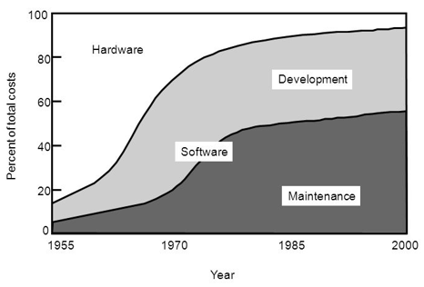
Relative distribution of software/hardware costs
Notes:
https://www.youtube.com/watch?v=H2tuKiiznsY&authuser=1

Slide 21
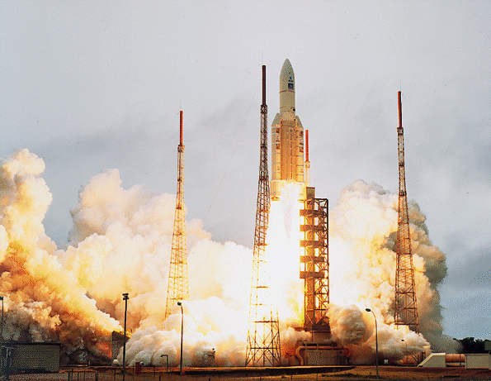

Fundamental Drivers
Late and Unreliable
Typically 35% of the computer based projects are runaway
70% of equipment failure in Defence is considered due to software
E.g. NASA Rocket Failure

Slide 22
ARIANE Flight 501
Disintegration after 39 sec
Caused by large correction for attitude deviation
Caused by wrong data being sent to On Board Computer
Caused by software exception in Inertial Reference System after 36 sec
Notes:
This was the maiden flight of the Ariane 5.
The Inertial Reference System determines the position of the rocket and its movements in space. It has its own computer, which computes angles and speeds based on information it gets from the ground station, lasers, etc. There are 2 IRS’s, which both failed.

Slide 23
The details
Overflow in conversion of variable BH from 64-bit floating point to 16-bit signed integer
Of 7 risky conversions, 4 were protected; BH was not
Reasoning: physically limited, or large margin of safety
In case of exception: report failure on data-bus and shut down
Notes:
BH - horizontal bias
Not all conversions were protected, for performance reasons

Slide 24
Possible explanations
Specification did not contain Ariane 5 trajectory data as a functional requirement
In tests, the SRI’s (components that measure altitude and movements of the launcher) were simulated by software modules
Inadequate testing
Improper reuse
Wrong design philosophy
Further Information if interested
IEEE Computer, jan. 1997, p. 129-130
http://www.cs.vu.nl/~hans/ariane5report.html
If a component works perfectly well in one environment, it doesn’t necessarily do so in another
Ariane 5 was much faster than Ariane 4, and horizontal velocity builds up more rapidly
⇒ excessive values for parameter in question
Wish for quick alignment after hold in shutdown
⇒ this software runs for a while after lift-off. It doesn’t have any purpose for the Ariane 5, but was still kept
If something breaks down, such is caused by a random hardware failure
Action: shut down that part
There is no provision for design errors
Notes:
In a sense, all these explanations are true
This shows the complexity of issues, and the trade-offs involved

Slide 25
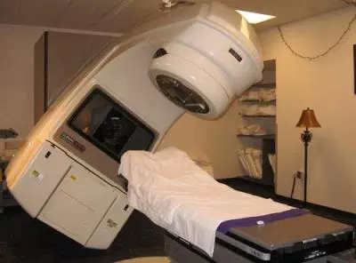
Fundamental Drivers
Can influence the life and death of a person
Therac 25 – (Radiation Therapy M/C) 6 People died due to over exposure to radiation – One cause a S/W bug
Heterogeneity
Systems are required to operate as distributed systems across networks that include different types of computer & mobile devices.
Diversity
There are many different types of software systems necessitating different techniques, methods and tools.
Business and Social change
Changes are happening quickly with economies & organizations getting more global, and availability of new technologies. Organizations need to have the ability to change their existing software to rapidly develop new S/W

Slide 26
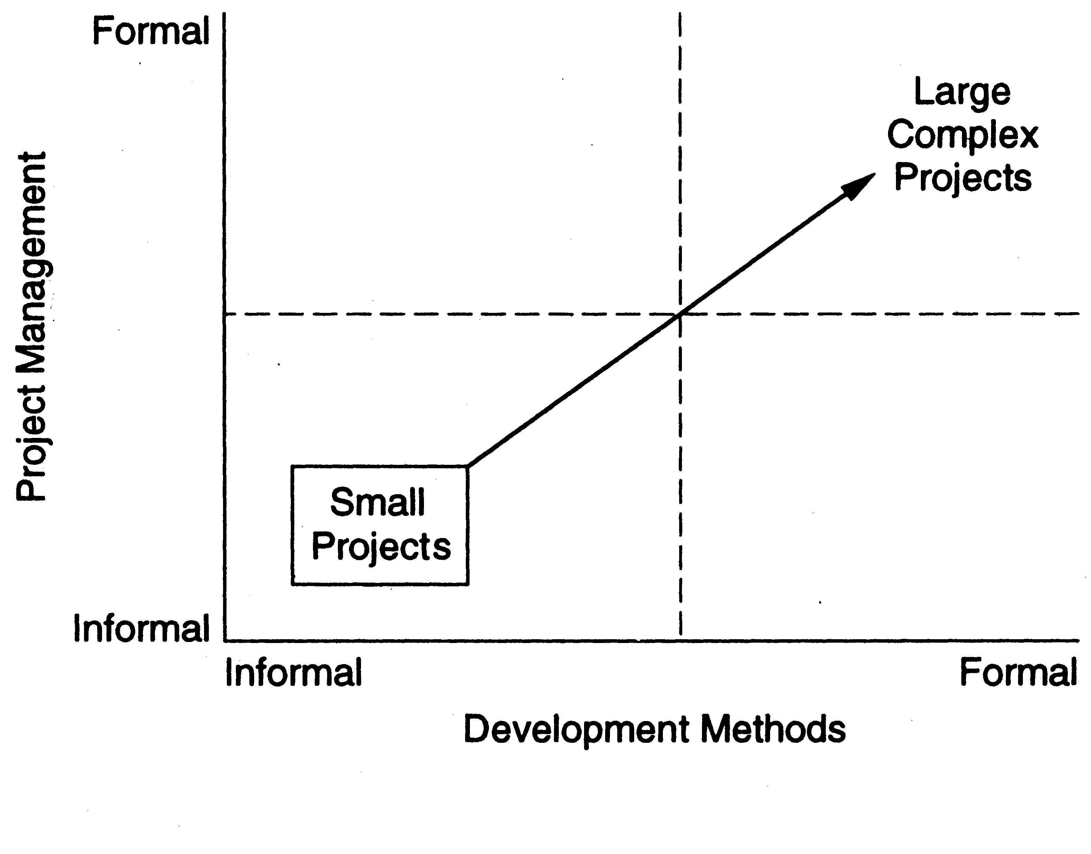
Fundamental Drivers
Security and Trust
SW is intertwined with all aspects of our lives, it is essential that we can trust that software
Scale
Processes and methodologies needs to scale easily with size
Quality and Productivity
Software quality which could be looked at as FLURPS+(efficiency or Maintainability) + Portability
Consistency and Repeatability
Notes:
Functionality Localizability Usability Reliability Performance Supportability
Questions on relevance of software engineering practice
Increasing Open Source Movement leading to questions on some of the engineering processes

Slide 27
Summarily Software Engineering is for
Development of BIG programs
Mastering complexity of these Large programs/Systems
Development of Software that is Evolving
Efficient development
Supporting large teams, teamwork and global development
Ensuring a process through which software being developed, supports the users effectively
Ensuring that the right choices or decisions are made while working under constraints or supports the balancing act
Ensuring the needs of visibility and continuity
Notes:
- Space Shuttle software: 40 million lines of code
- complexity often is not “mathematical” complexity, but caused by the myriad of details to be handled
- reality changes, so the software has to change as well (e.g. salary administration and changing tax regulations)
- software costs a tremendous amount of money (it is very labor intensive)
- OS 360 cost 5000 person years (so you need rules and regulations - hence process models)
- so user involvement
- software engineers tend to have little knowledge of the application domain

